Slide 1
Web scraping on Flipkart.com
Data science & it’s applications
(21ad62)
Gagan d n (1ce21ai009)
Kailash rao (1ce21ai010)

Slide 2
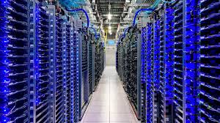
Data:
Data refers to raw, unprocessed facts, figures, and details that are collected from various sources.
It can be qualitative (descriptive information) or quantitative (numerical information).

Slide 3
Importance of data
Informed Decision-Making
Performance Measurement
Customer Insights
Operational Efficiency
Market Analysis
Innovation and Development
Risk Management
Compliance and Reporting
Personalization
Scientific Research

Slide 4
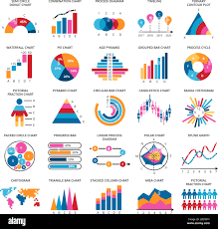
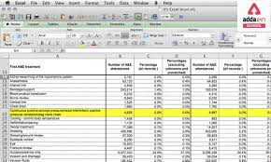
Data analysis & visualization

Slide 5
Process of data visualization
Define Objectives
Collect and Prepare Data
Explore and Analyze Data
Select Visualization Techniques
Design the Visualization
Implement the Visualization
Test and Refine
Present and Share
Evaluate and Iterate

Slide 6
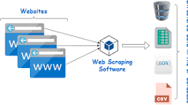
Web scraping
Web scraping is the automated process of extracting data from websites.

Slide 7
Steps in web scraping
Identify the Target Website
Inspect the Web Page
Set Up the Environment
Send HTTP Requests
Parse the HTML Content
Extract the Data
Handle Pagination and Dynamic Content
Store the Data
Maintain and Update the Scraper

Slide 8
Python libraries used
from bs4 import BeautifulSoup
import requests
import pandas as pd
import numpy as np
import pandas as pd
import matplotlib.pyplot as plt
import numpy as np

Slide 9
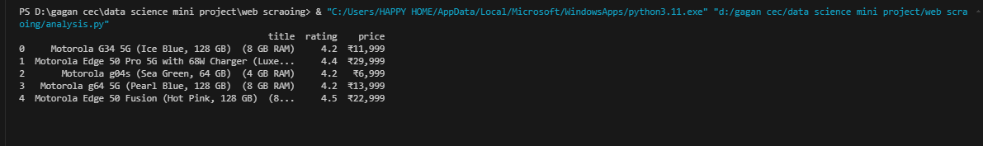
Reading csv file

Slide 10
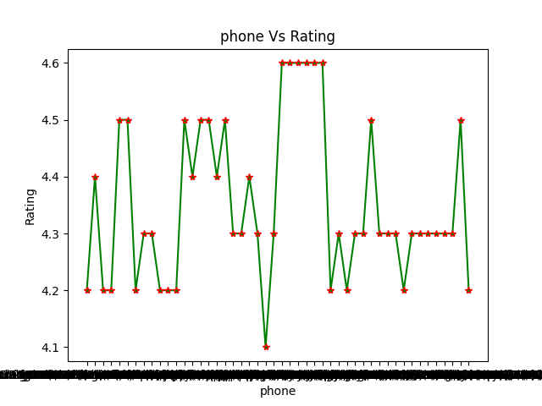
Phone v/s rating

Slide 11
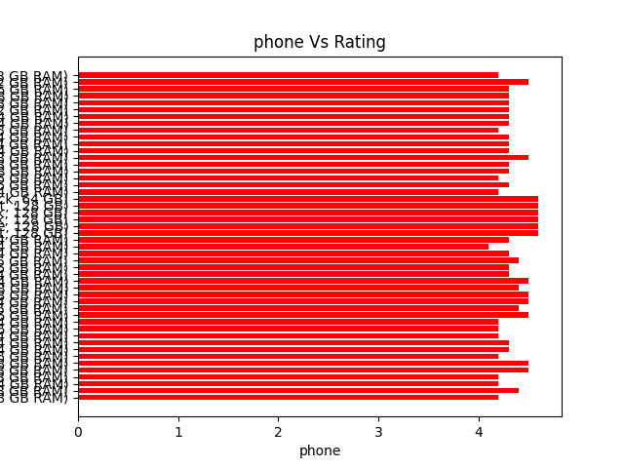
Phone v/s rating(hbar)

Slide 12
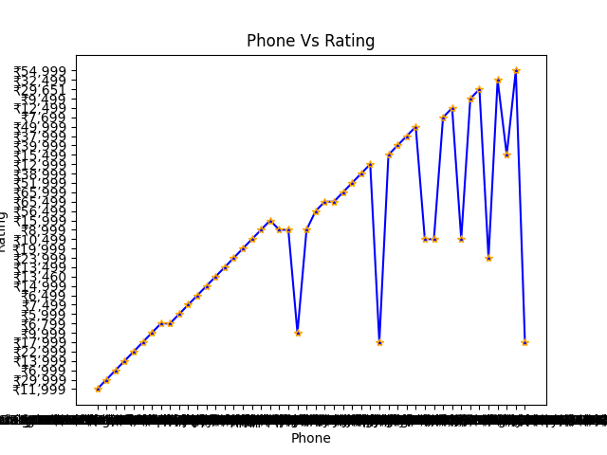
Phone v/s rating (plot)

Slide 13
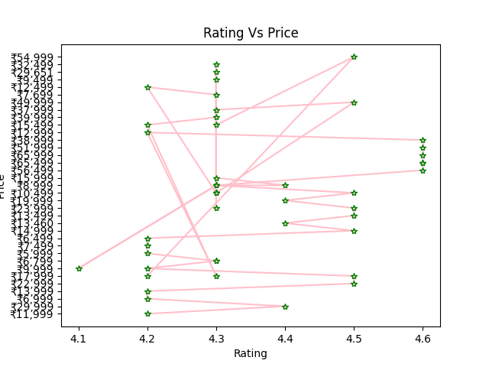
Line plot(rating v/s price)

Slide 14
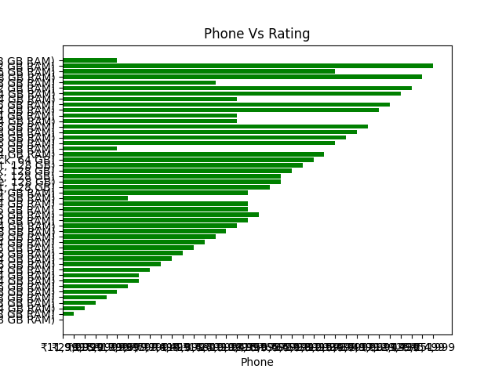
Phone v/s rating(hbar)

Slide 15
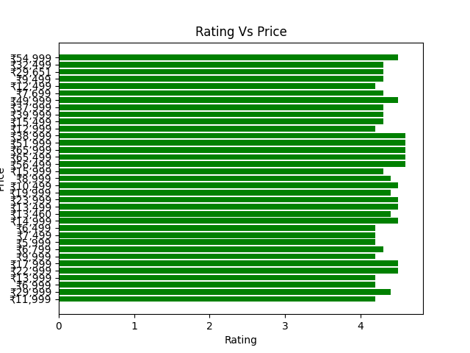
Rating v/s price(hbar)

Slide 16
Thank you

